Slide 1
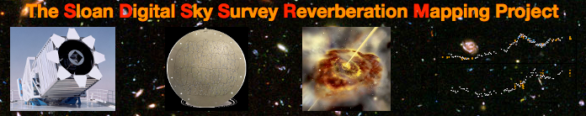
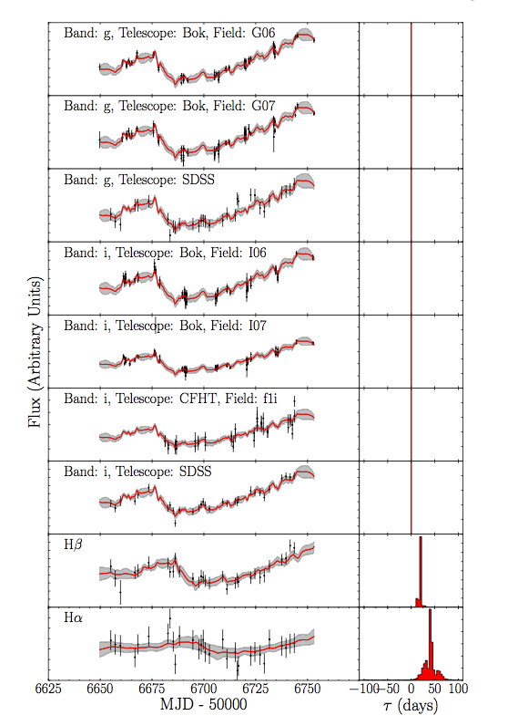
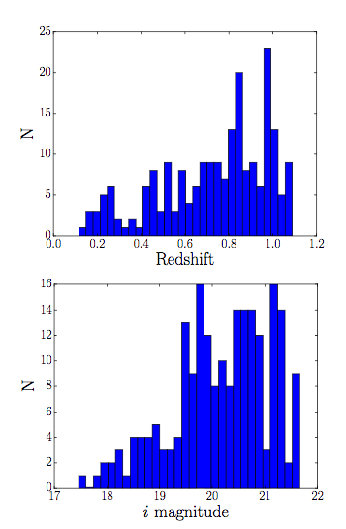
Sloan Digital Sky Survey – Reverberation Mapping
SCIENCE GOALS: To explore the potential of reverberation mapping for a large homogenous sample of broad-line quasars.
849 quasar sample i < 21.7 (flux limited) in 7 deg².
222 of these with required redshift range for detectable Hβ line (useful for estimating M_{BH}).
What can we learn about the accretion disk by studying variability in g and I lightcurves.
[Grier et al 2017]
Notes:
FLUX LIMITED SAMPLE
NGC 5548 much closer and so much brighter i band ~ 13
hbeta wavelength n = 4 -> 2, lambda = 4861A

Slide 2
Progress report Feb 2018
merge sdss & panstarrs light curves.
sdss g & i band continuum light curve study.
error bar treatment
accretion disc parameters
simulated light curves
write-up
Accretion disc temperature structure and dependence on vertical disc profile – rippled disk project.
accretion disk models, spectra, response functions & comparison with NGC 5548.
Write-up

Slide 3
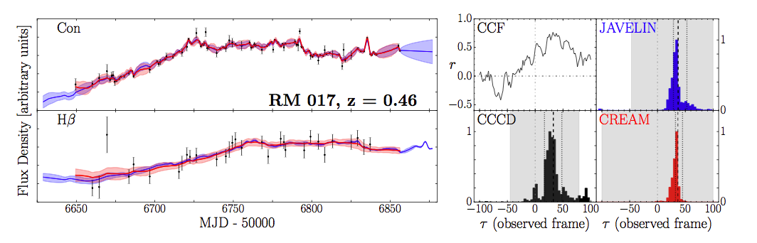
Continuum REverberAtion MCMC
Simultaneous continuum merging and Line lag detection. Starkey + 2017
Grier + 2017 interested in line lags. What about continuum g – i lags?
RM272 – CREAM Grier + 2017
RM017 CREAM/ JAVELIN/ CCF comparison
Grier + 2017

Slide 4
g to i lags for rm Quasars…
Bias toward +ve g to I band lags

Slide 5
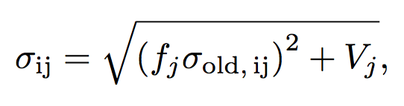
SDSS – error bar treatment
Three methods of treating suspect error bars
1 - (Standard)
As above but P(f) = G(1,f_pri) and P(var) = G(0,V_pri) 2 – (prior)
As (1) but fixing the line error bars (f==1 and V == 0) 3 – (fix line)

Slide 6
Test of different noise models on example rm789 SDSS light curve Standard

Slide 7
Test of different noise models on example rm789 SDSS light curve Prior

Slide 8
Test of different noise models on example rm789 SDSS light curve fix line

Slide 9
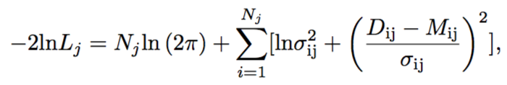
Outlier Rejection Statistics
CREAM treats ‘bad’ data by expanding their error bars.
Expanding error bars penalised by ‘badness of fit’ (BOF) term
Penalty
χ²
Some rogue ‘bad’ data can still skew the MCMC fit to inaccurate parameter estimates. Apply outlier rejection system to dampen the weight of ‘bad’ data on the BOF.

Slide 10
Tests on synthetic data

Slide 11
Continuum Lag Detection Problem
CREAM fast(ish) when merging light curves and simultaneously fitting top-hat response to get the line lags.
Continuum response functions much wider so need additional computation time.
Will need to measure accretion disc lags between merged SDSS and PANStarrs continuum bands. Need to speed up code somehow.
Continuum
response
~ 10 days wide
top-hat
response
~ 0.2 days wide

Slide 12
Affine Invariance
Use correlations between parameters to decide direction to ‘step’ in the MCMC chain.
For an identical number of steps, affine sampling more efficiently samples the posterior parameter space. Will now implement this into cream to reduce the number of iterations required to converge.

Slide 13
When to Start Affine Stepping?
Need to build up enough points to make a posterior probability cloud.
So we know the direction to step in parameter space.
10⁵ Iterations

Slide 14
1000 Iterations
For a 10⁵ iteration run, can start affine stepping in first ~1000 iterations
Speed up convergence?

Slide 15
The Good

Slide 16
…the bad

Slide 17
… the ugly

Slide 18
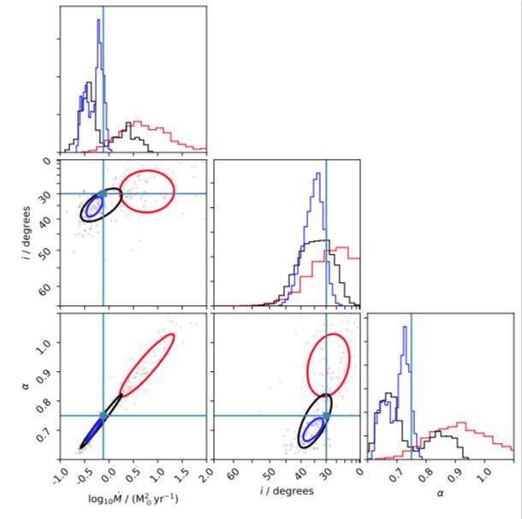
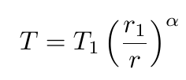

Slide 19
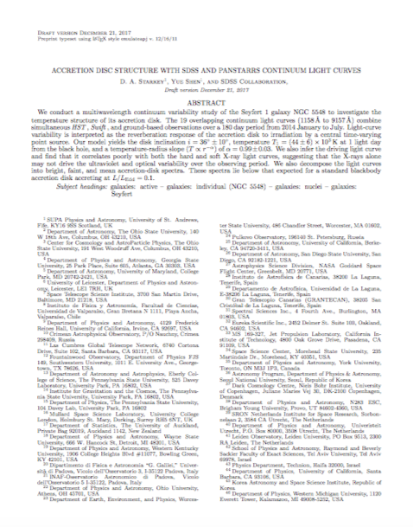
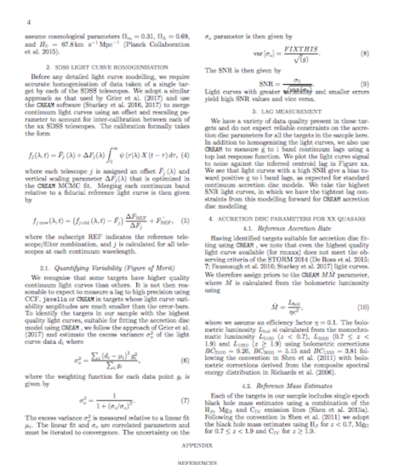
Write – Up Results

Slide 20
Conclusions
Broadly similar peaks posterior positions but notable differences in choppiness and width.
Need to settle on a standardized treatment before merging panstarrs and SDSS light curves

Slide 21
Accretion disk temperature profiles and dependence on vertical structure
Altering the vertical profile (top left – power law) can effect significant changes in the temperature profile of the disc?
Can this effect explain the large lags?

Slide 22
… and rippled structure

Slide 23
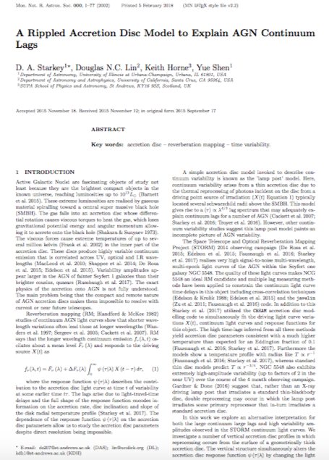
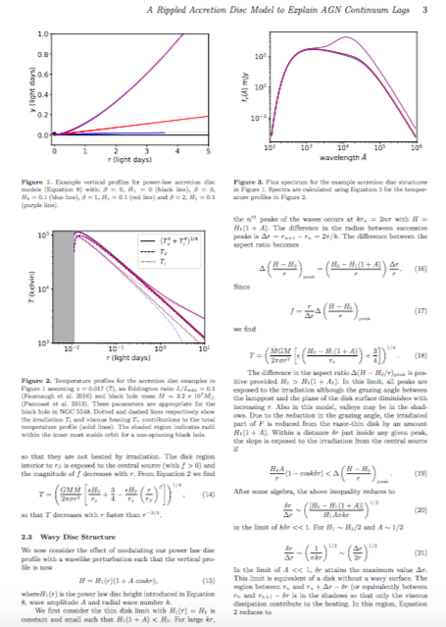

Slide 24

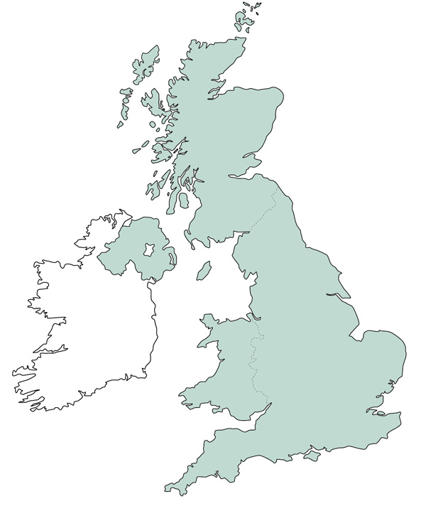
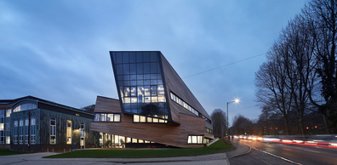

St Andrews
Edinburgh
Durham
Lancaster

Slide 25
Durham Edinburgh (St Andrews, Lancaster, Illinois, ;), EXtra Galactic Astronomy Meeting
Back to the future: astronomy with next generation instruments and simulations (E-ELT, TMT, LSST, Euclid, JWST, eROSITA, ATHENA along with increasingly more detailed simulations such as APSOSTLE, C-EAGLE and MUFASA)
What can big surveys, simulations can do for Xtra galactic astronomy?
Broadly divided into Surveys, AGN, Cosmos, Lensing, Galaxy Evolution.
All talks found on the website: http://www.astro.dur.ac.uk/DEX/XIV/

Slide 26
SURVEYS

Slide 27
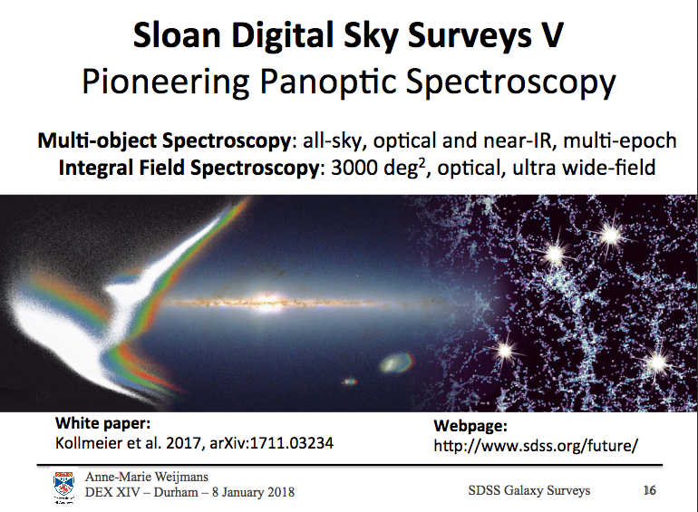

Slide 28
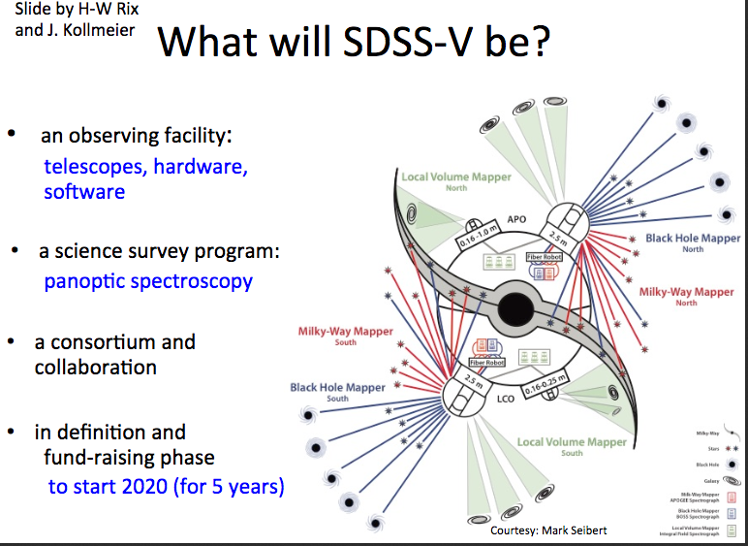
Notes:
sdss-rm project is SDSS-III

Slide 29
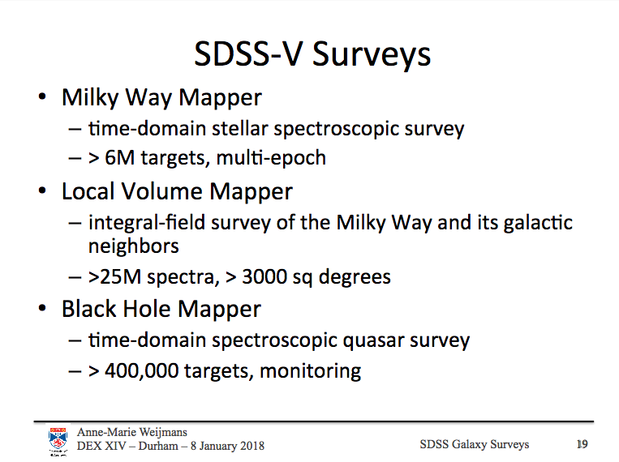
Notes:
What is the cadence of the time domain black hole mapper survey?
3000 → 10,000 A coverage (great for rm Hbeta n=4-2 4860A z<2, CIV 1500A z > 2 and continuum studies)

Slide 30
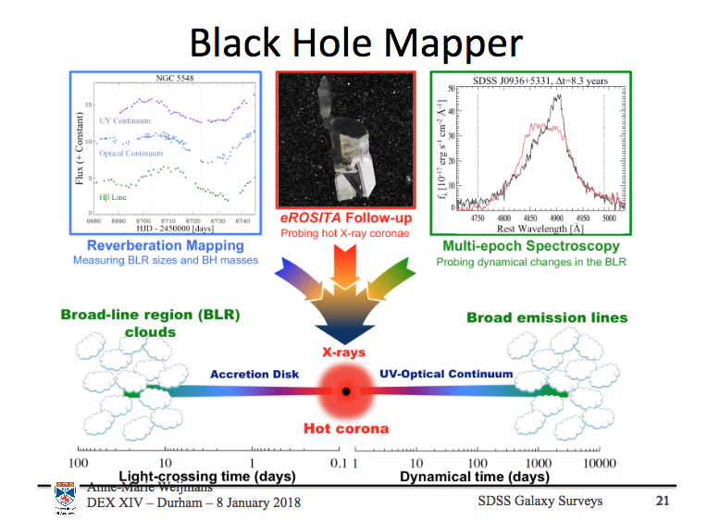
Notes:
erosita X-ray (built by MPE launch by the russians) telescope launch ~2018 will follow up on SDSS black hole mapper targets to study X-ray corona

Slide 31
AGN

Slide 32
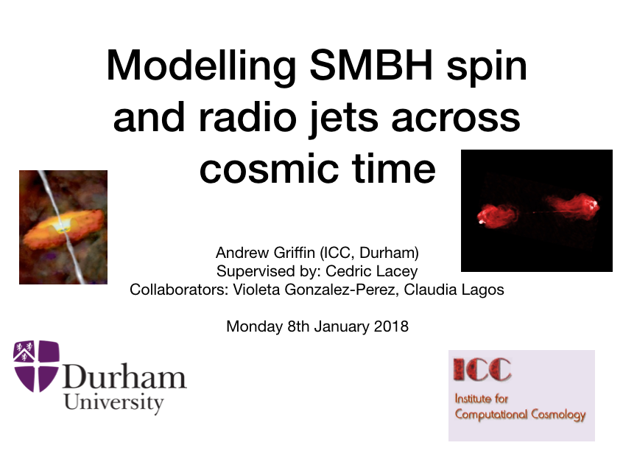

Slide 33
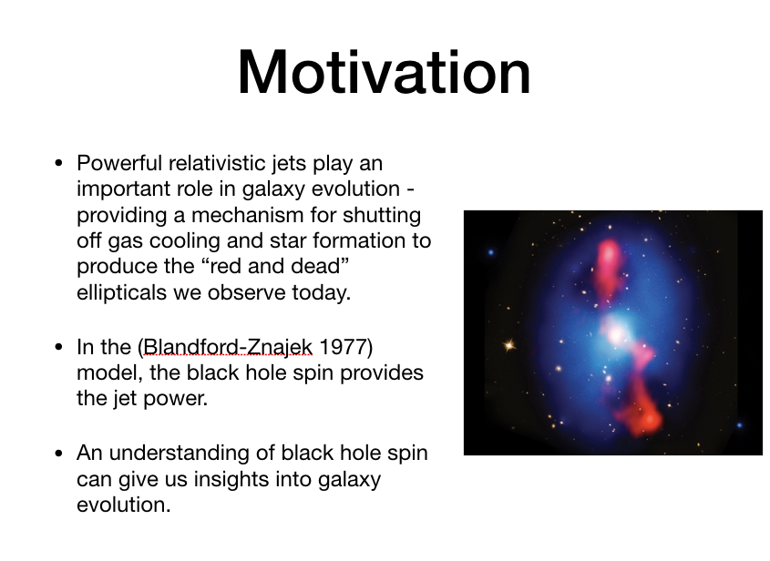

Slide 34
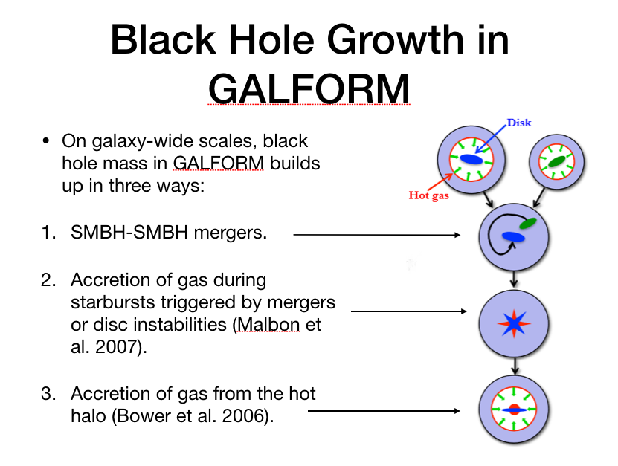

Slide 35
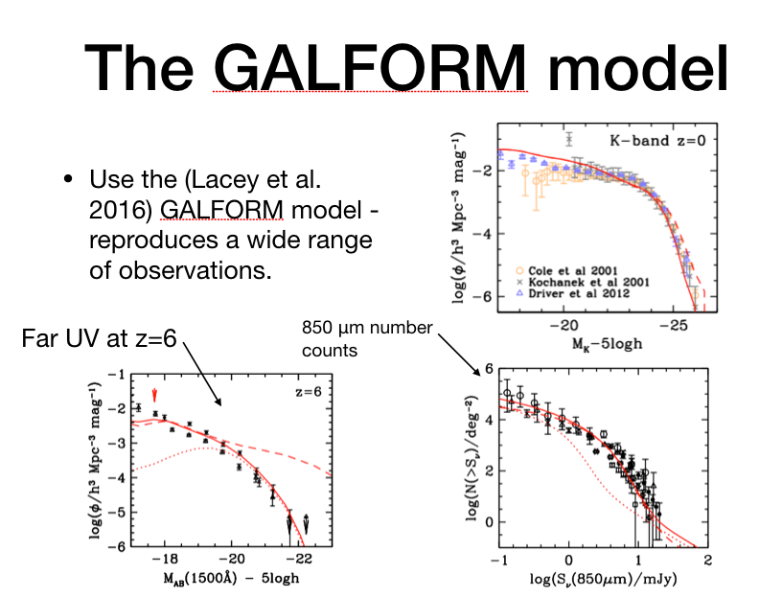

Slide 36
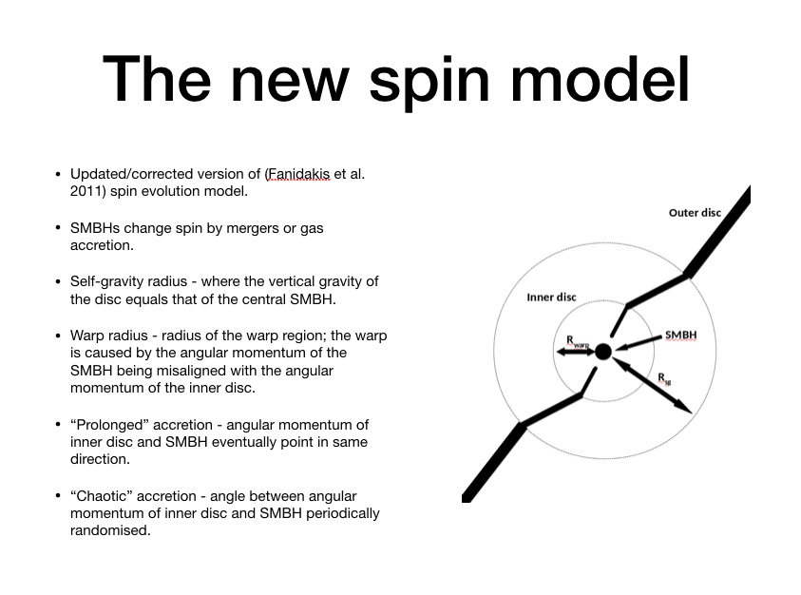

Slide 37
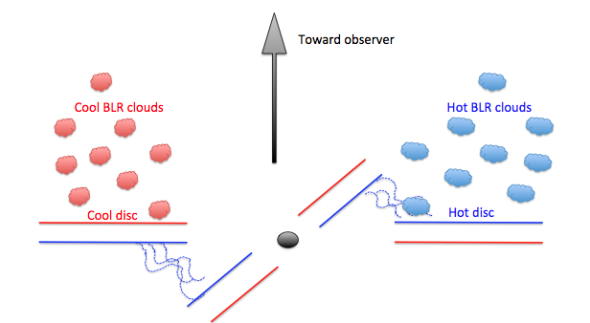
Why I liked the GALFORM talk!
. SPH models predict misalignment between an outer accretion disc and an inner disc at some radius due to the accretion disc re-orientating to the spin of the black hole (Nealon et al 2015).

Slide 38
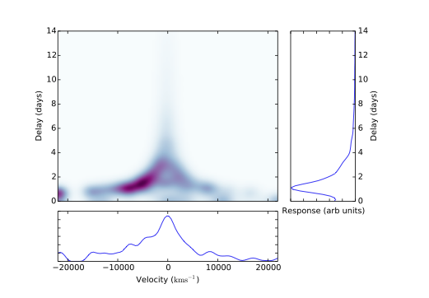
Asymmetric Heating
Asymmetric delay map also found in Arp 151 (Bentz et al 2011) also can be caused by in-fall / outflowing BLR material.

Slide 39
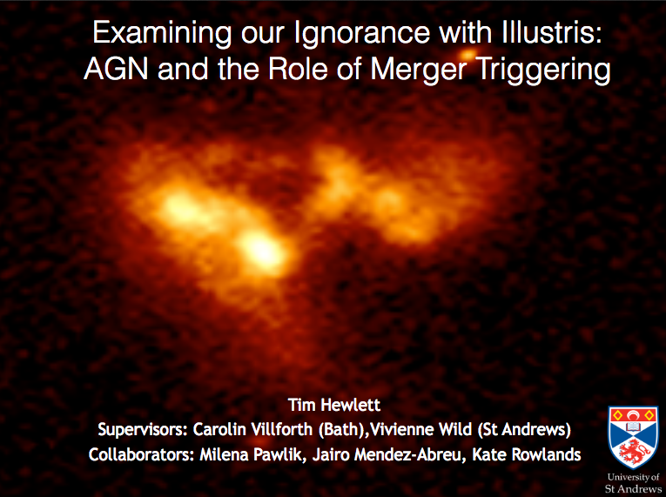

Slide 40
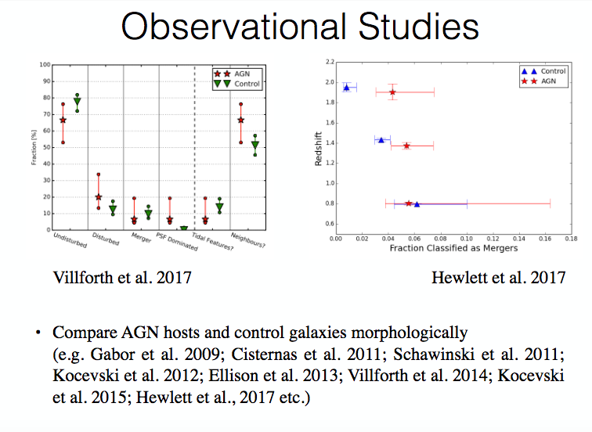
Notes:
Are AGN triggered by major mergers? Some tentative evidence to suggest this may be the case at high redshit (compare the AGN and control sample of a large sample of galaxies), but may correlation doesn’t imply causation. Other problems with studies like this. How to identify mergers (story of Tim teaching a lecture in Viviennes class and the students being worse than random number generator at classifying AGN)
May only indirectly trigger the AGN eg…

Slide 41
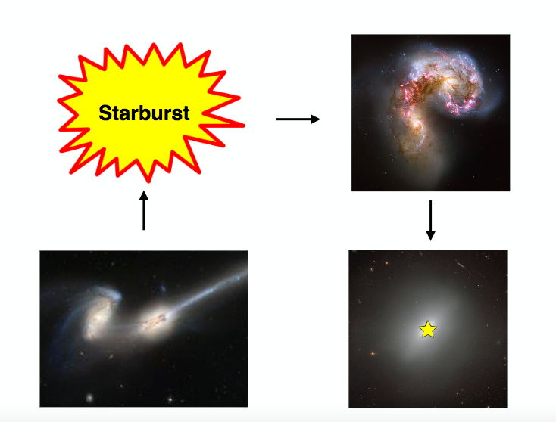
Notes:
mergers trigger starburst that then triggers AGN.

Slide 42
Galaxy Evolution

Slide 43
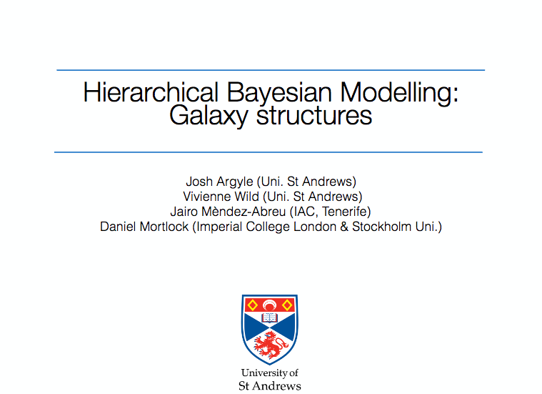

Slide 44
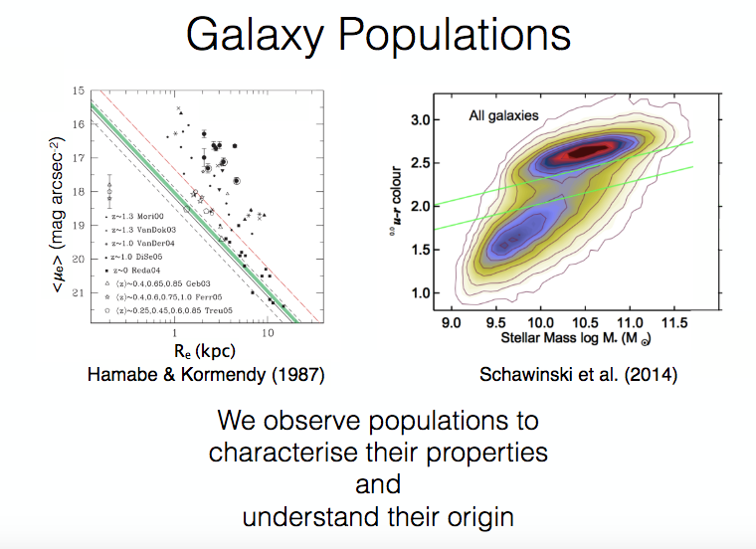

Slide 45
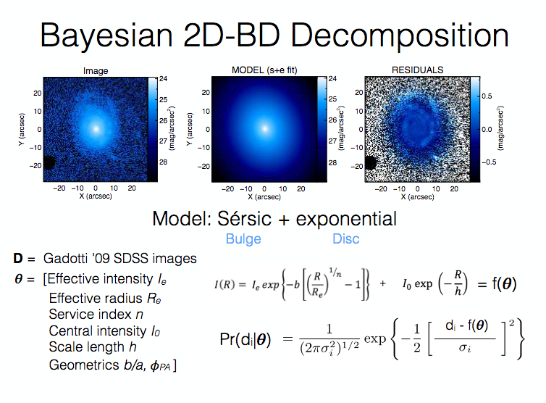

Slide 46
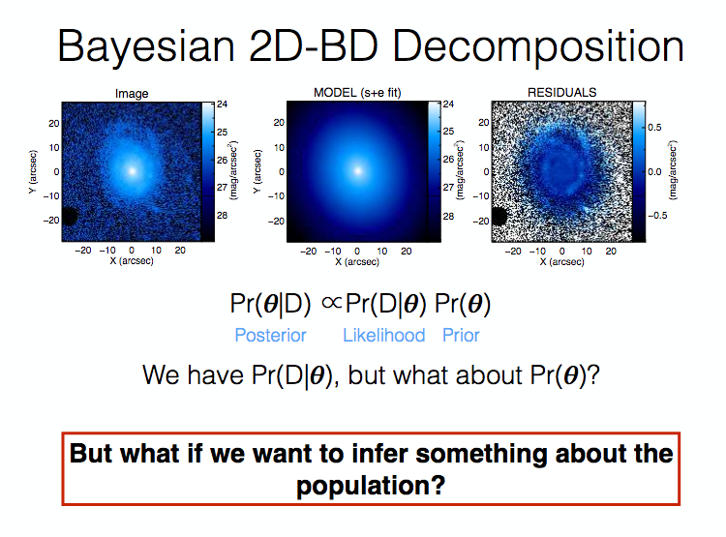
Notes:
rather than use individual priors, use prior distributions based on previous observations of large sample populations.

Slide 47
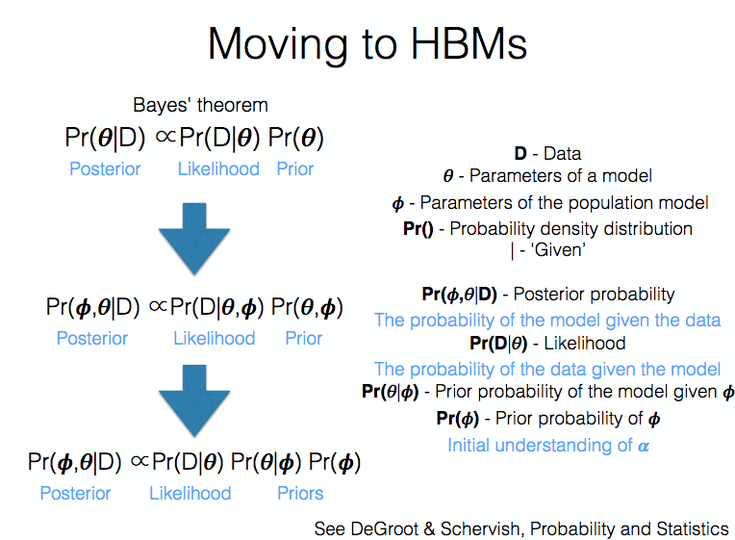
Notes:
Normal Bayesian models have likelihood and prior terms. What if we know (from population studies) some extra information on the expected behavior of the parameters given the population model. Interesting for me as this is the first time I have gone from dealing with one AGN and now dealing with 1000. Statistical modeling of the population may become important rather than just modelling each AGN one by one independently.

Slide 48
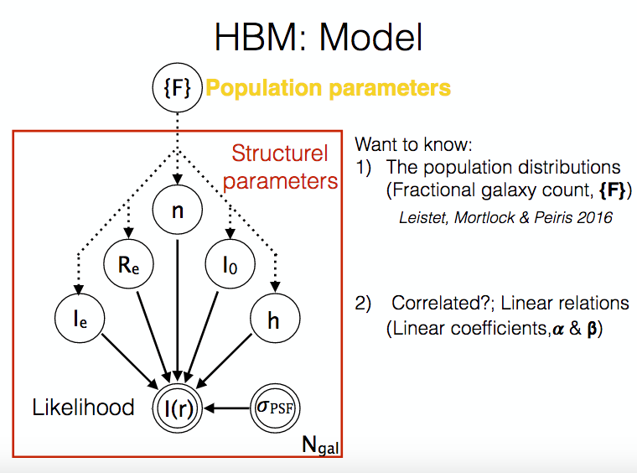
Notes:
An example of a population parameter would be the redshift distribution rather than individual redshift

Slide 49
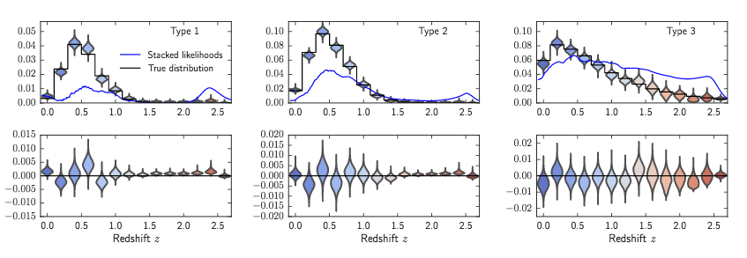
Applications of Hierarchical Bayesian Inference
redshift distributions inferred from fake data (mortlock + 2017, See also Argyle et al submitted)
Attempt to recover redshift distribution from a fake galaxy sample (violin plots).
Incorporating ‘population’ priors using hierarchical techniques (black solid line) improves on traditional individual fitting techniques (blue line).
Notes:
Other noteworthy mentions. Clustering redshifts:
To understand universe need to know distances to objects, gives us info on universal composition. Distances come from redshift with some cosmological model. Need good redshift estimates to do this study. Spectroscopic redshfits only possible for bright objects with clear resvolvable emission features. Photometric redshifts require a priori knowledge of the type of object observed and are prone to failure.The onset of new studies with thousands of new objects makes accurate redshift determination a serious issue for future of astronomy.
Clustering based redshift estimates rely on informration encoded within the clustering of matter rather than in the features of the SED. Paper underway (Bates + in prep) to test performance of clustering based redshift estimation.

Slide 50
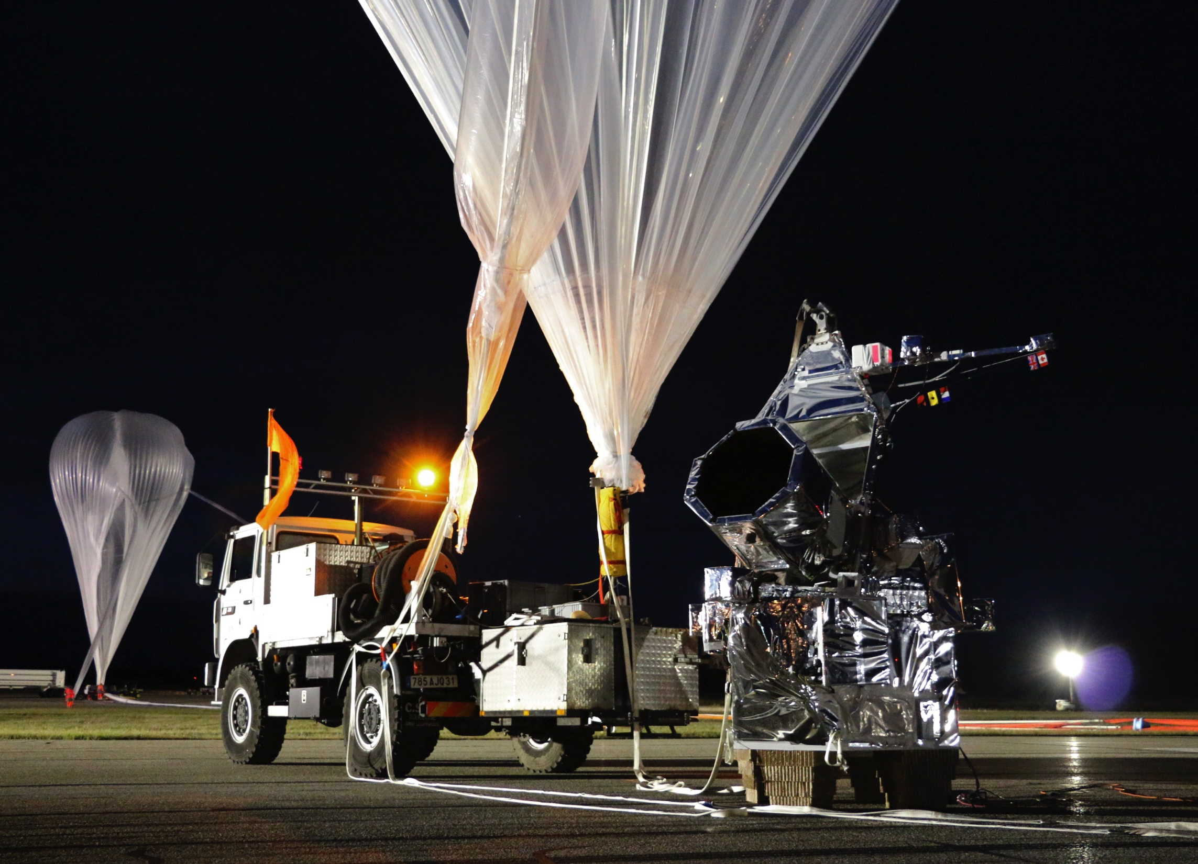
SuperBIT
Superpressure Balloon-borne Imaging Telescope

Slide 51

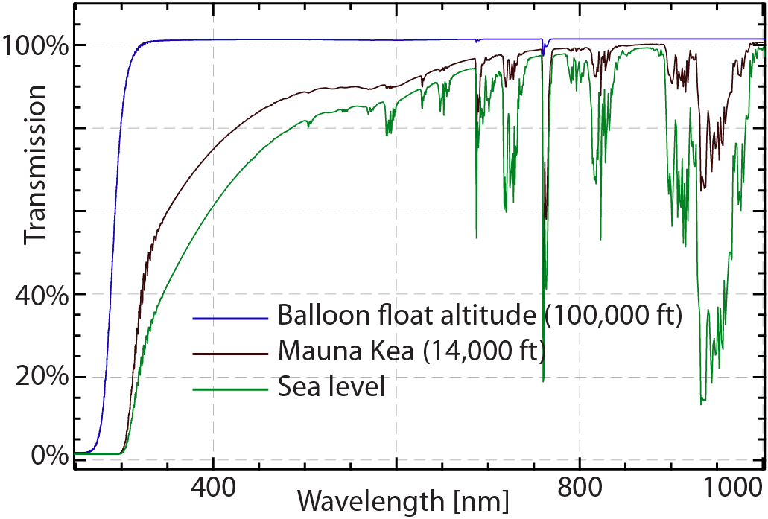
Why go above the atmosphere? space-quality optical & UV imaging, on a university budget
SuperBIT
Superpressure Balloon-borne Imaging Telescope
For transmission and seeing, a telescope at 35km altitude (above 99% of the atmosphere) is effectively in space
Notes:
SuperBIT is a joint project by Toronto, Princeton, JPL and Durham, to build a UV/optical telescope on a high altitude balloon, exploiting heritage from CMB balloon missions: BLAST/SPIDER/STABLE.
For less than 1% the cost of a space mission (and in much quicker time), it is possible to reach an altitude of 100,000 ft (30,000 m). Above 99% of the Earth’s atmosphere, the platform will see effectively space-quality transmission and seeing. It will be able to do essentially everything that HST could do in the UV/optical, and the facility for high resolution, fast UV imaging will be unique once HST dies.
This is a photo of the payload, assembled in a lab in Toronto. It is scheduled for two 24 hour-long test flights next year (to verify performance), and we have just requested a science flight on an ultra-long duration balloon in 2017. These new “superpressure” balloons are made from cutting edge materials that expand to the size of a football stadium at altitude (without leaking) and keep the payload afloat for 3-4 months.
We plan to launch from New Zealand, and circumnavigate the Earth several times, observing during the night and recharging batteries during the day. The payload can (usually) be recovered and relaunched, perhaps after changing/upgrading/repairing the instrument.

Slide 52
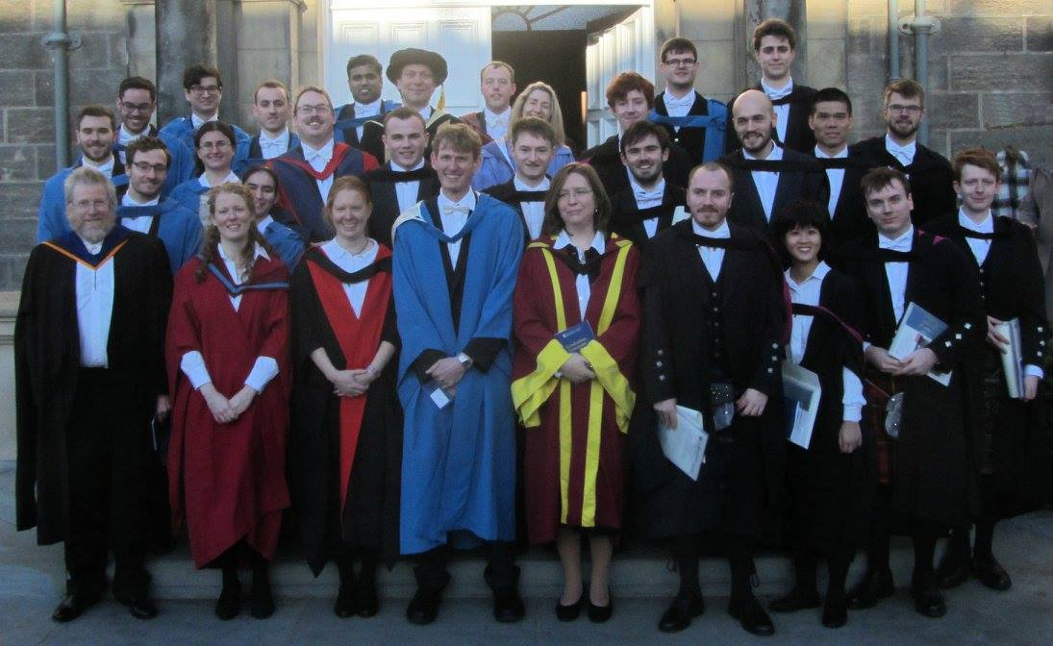

Slide 53
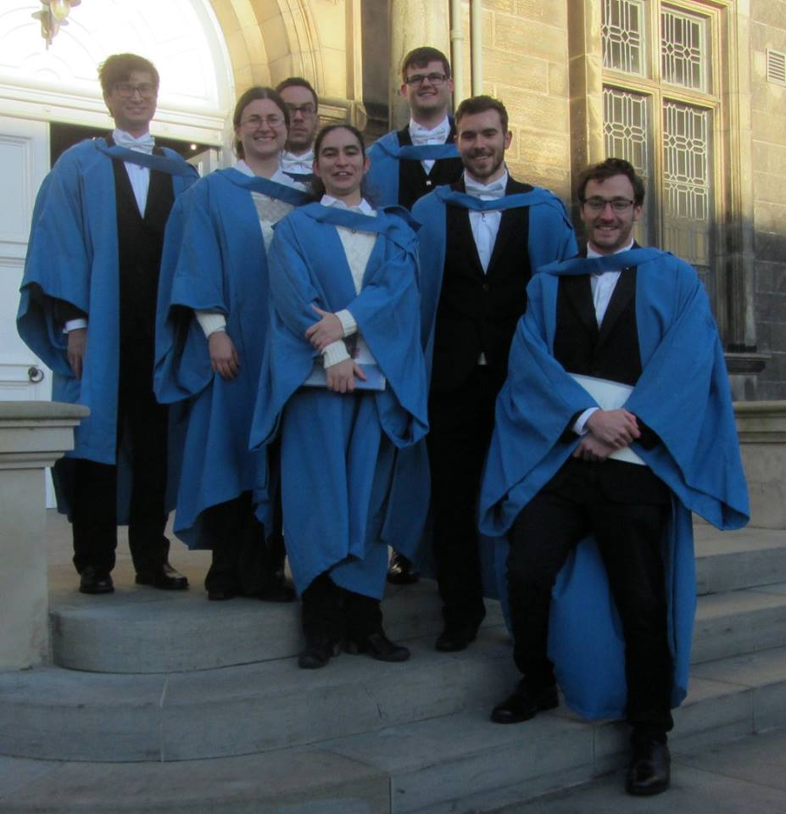

Slide 54
Panstarrs – SDSS offset g

Slide 55
i

Slide 57
Panstarrs → sdss examples rm005

Slide 58
Panstarrs → sdss examples rm272

Slide 59
Diagnostic plots
Expect sdss-to-panstarrs offsets distributed around 0.

